Slide 1
IT-331 ( Computer Graphics 1)
Lecture 2
Line - Drawing Algorithms
DDA
Dr. Mohammed El-Said
Assistant Professor, Computer Science Dept.,
Faculty of Computers & Artificial Intelligence,
Helwan University - Cairo, Egypt.

Slide 2
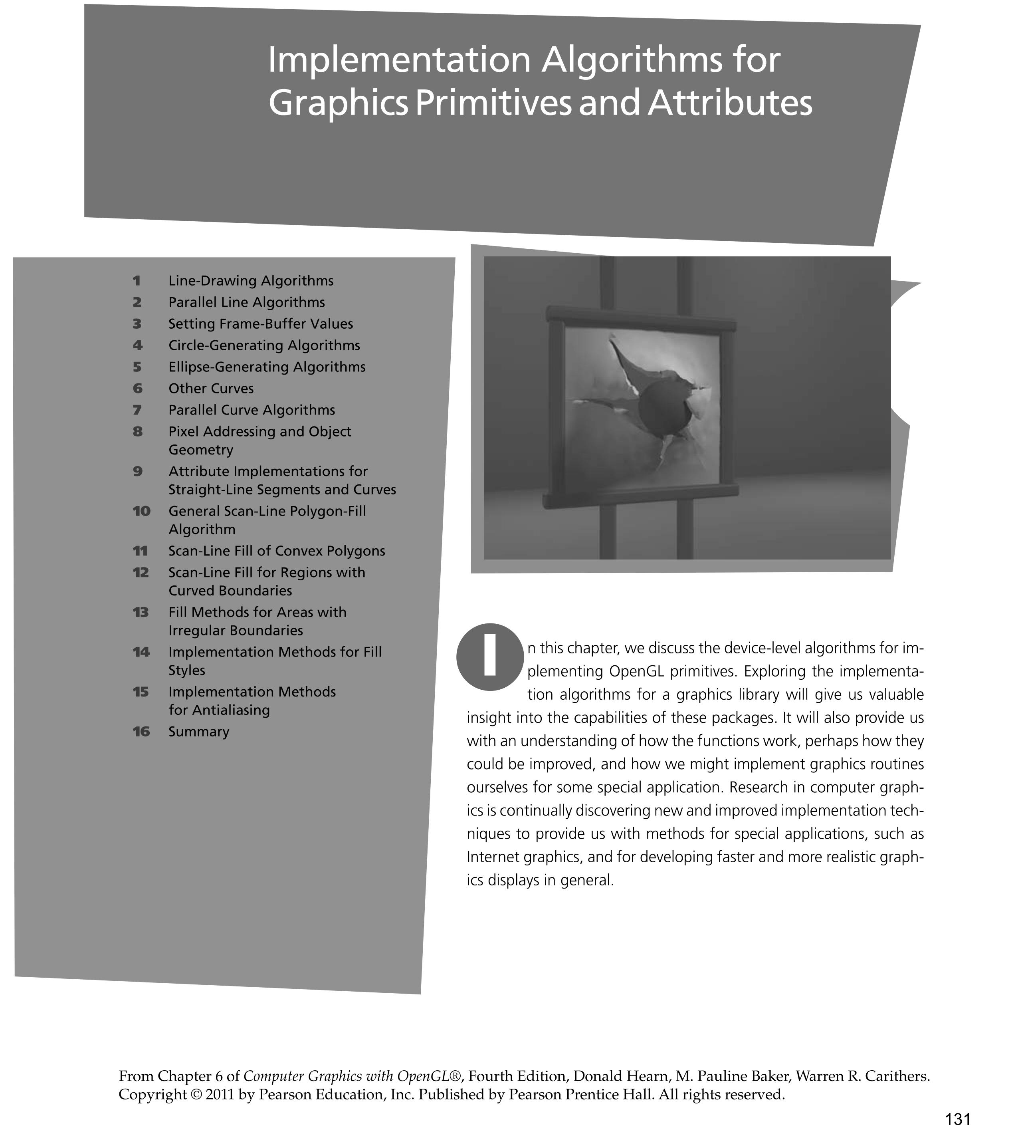

Slide 3
Basic Elements
Two basic elements
Points
Vectors
Points are associated with locations in space
Vectors have magnitude and direction
represent displacements between points, or directions

Slide 4
Basic Elements
Points, vectors, and operators that combine them are the common tools for solving many geometric problems that arise in
Geometric Modeling,
Computer Graphics,
Animation,
Visualization, and
Computational Geometry.

Slide 5
COORDINATE REFERENCE FRAMES
Scan-line algorithms for the graphics primitives use the coordinate descriptions to determine the locations of pixels
E.g., given the endpoint coordinates for a line segment, a display algorithm must calculate the positions for those pixels that lie along the line path between the endpoints.
Since a pixel position occupies a finite area of the screen
the finite size of a pixel must be taken into account by the implementation algorithms.
for the present, we assume that each integer screen position references the centre of a pixel area.

Slide 6
COORDINATE REFERENCE FRAMES
Once pixel positions have been identified the color values must be stored in the frame buffer
Assume we have available a low-level procedure of the form
setPixel (x, y);
stores the current color setting into the frame buffer at integer position (x, y), relative to the position of the screen-coordinate origin
getPixel (x, y, color);
retrieves the current frame-buffer setting for a pixel location;
parameter color receives an integer value corresponding to the combined RGB bit codes stored for the specified pixel at position (x,y).
additional screen-coordinate information is needed for 3D scenes. For a two-dimensional scene, all depth values are 0.

Slide 7
LINE-DRAWING ALGORITHMS
A straight-line segment in a scene is defined by the coordinate positions for the endpoints of the segment.
To display the line on a raster monitor, the graphics system must
first project the endpoints to integer screen coordinates and
determine the nearest pixel positions along the line path between the two endpoints.
Then the line color is loaded into the frame buffer at the corresponding pixel coordinates.
Reading from the frame buffer, the video controller plots the screen pixels.
This process digitizes the line into a set of discrete integer positions that, in general, only approximates the actual line path.

Slide 8
LINE-DRAWING ALGORITHMS
On raster systems, lines are plotted with pixels, and step sizes in the horizontal and vertical directions are constrained by pixel separations.
That is, we must "sample" a line at discrete positions and determine the nearest pixel to the line at sampled position.
Sampling is measuring the values of the function at equal intervals
Idea: A line is sampled at unit intervals in one coordinate and the corresponding integer values nearest the line path are determined for the other coordinate.

Slide 9
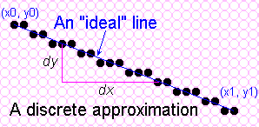
Towards the Ideal Line
We can only do a discrete approximation
Illuminate pixels as close to the true path as possible, consider bi-level display only
Pixels are either lit or not lit
In the raster line alg.,
we sample at unit intervals and
determine the closest pixel position to the specified line path at each step

Slide 10
What is an ideal line
Must appear straight and continuous
Only possible with axis-aligned and 45º lines
Must interpolate both defining end points
Must have uniform density and intensity
Consistent within a line and over all lines
What about anti-aliasing ?
Aliasing is the jagged edges on curves and diagonal lines in a bitmap image.
Anti-aliasing is the process of smoothing out those jaggies.
Graphics software programs have options for anti-aliasing text and graphics.
Enlarging a bitmap image accentuates the effect of aliasing.
Must be efficient, drawn quickly
Lots of them are required

Slide 11
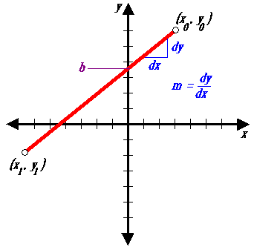
Simple Line
The Cartesian slope-intercept equation for a straight line is :
y = mx + b
with m as the slope of the line and b as the y intercept.
Simple approach:
increment x, solve for y

Slide 12
Line-Drawing Algorithms: DDA Bresenham’s Midpoint Algorithm

Slide 13
Algorithms for displaying lines are based on the Cartesian slope-intercept equation
y = m.x + b
where m and b can be calculated from the line endpoints: m = (y1-y0) / (x1-x0)
b = y0 - m. x0
For any x interval δx along a line the corresponding y interval δy = m.δx
y₁
y₀
x₀
x₁

Slide 14
Simple Line
Based on slope-intercept algorithm from algebra:
y = mx + b
Simple approach:
increment x, solve for y
Floating point arithmetic required

Slide 15
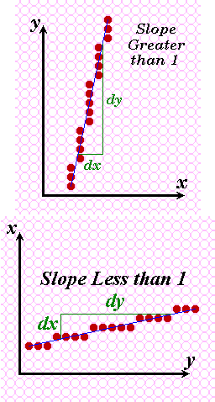
Does it Work?
It works for lines with a slope of 1 or less,
but doesn’t work well for lines with slope greater than 1 – lines become more discontinuous in appearance and we must add more than 1 pixel per column to make it work.
Solution? - use symmetry.

Slide 16
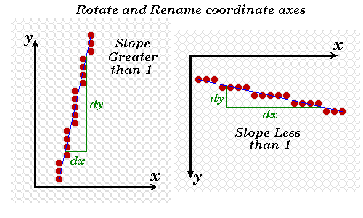
Modify algorithm per octant
OR, increment along x-axis if dy<dx else increment along y-axis

Slide 17
DDA Algorithm
The digital differential analyser (DDA) is a scan-conversion line algorithm based on using δx or δy.
A line is sampled at unit intervals in one coordinate and the corresponding integer values nearest the line path are determined for the other coordinate.

Slide 18
Line with positive slope
If m<=1,
Sample at unit x intervals (dx=1)
Compute successive y values as
y_{k+1}=y_{k}+m 0<=k<=x_{end}-x₀
Increment k by 1 for each step
Round y to nearest integer value.
If m>1,
Sample at unit y intervals (dy=1)
Compute successive x values as
x_{k+1}=x_{k}+1/m 0<=k<=y_{end}-y₀
Increment k by 1 for each step
Round x to nearest integer value.

Slide 19
inline int round (const float a) { return int (a + 0.5); }
void lineDDA (int x0, int y0, int xEnd, int yEnd)
{
int dx = xEnd - x0, dy = yEnd - y0, steps, k;
float xIncrement, yIncrement, x = x0, y = y0;
if (fabs (dx) > fabs (dy))
steps = fabs (dx);
else
steps = fabs (dy);
xIncrement = float (dx) / float (steps);
yIncrement = float (dy) / float (steps);
setPixel (round (x), round (y));
for (k = 0; k < steps; k++) {
x += xIncrement;
y += yIncrement;
setPixel (round (x), round (y));
}
}

Slide 20
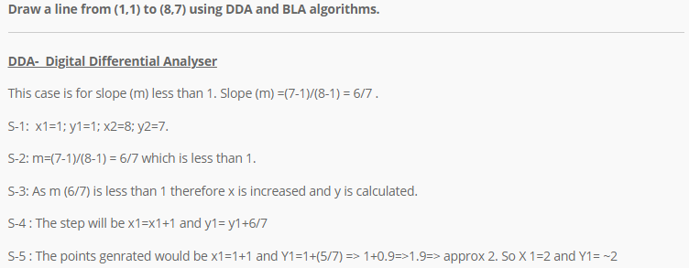
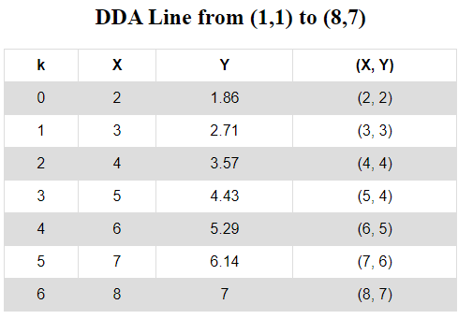

Slide 21
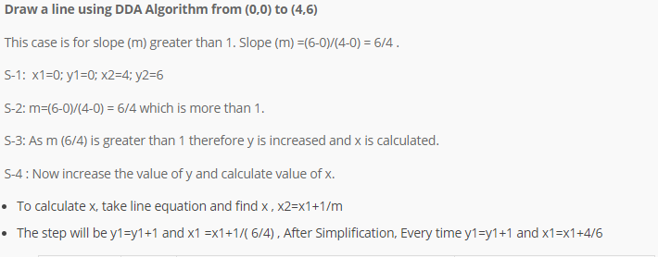
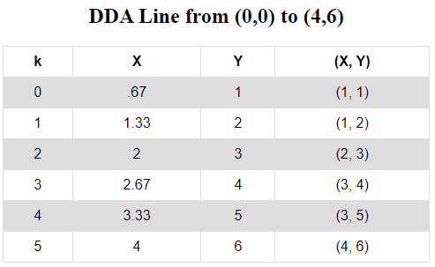

Slide 22
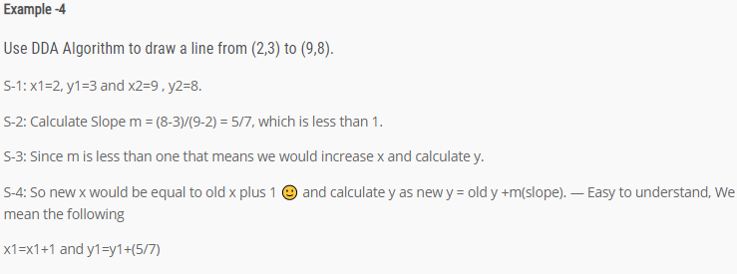
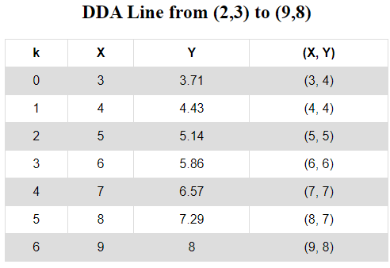
3

Slide 23
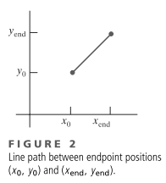

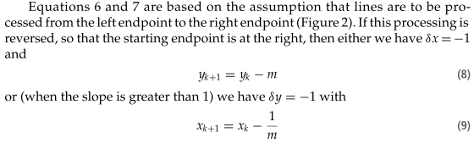

Slide 24
DDA algorithm
Need a lot of floating point arithmetic.
2 ‘round’s and 2 adds per pixel.
Is there a simpler way ?
Can we use only integer arithmetic ?
Easier to implement in hardware.

